Slide 1
Olympic Games Analysis
Business Problem

Slide 2
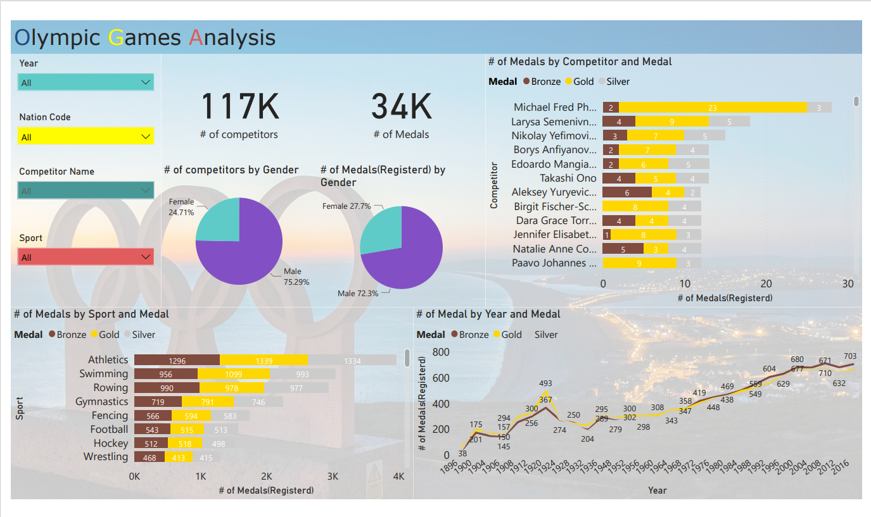

Slide 3
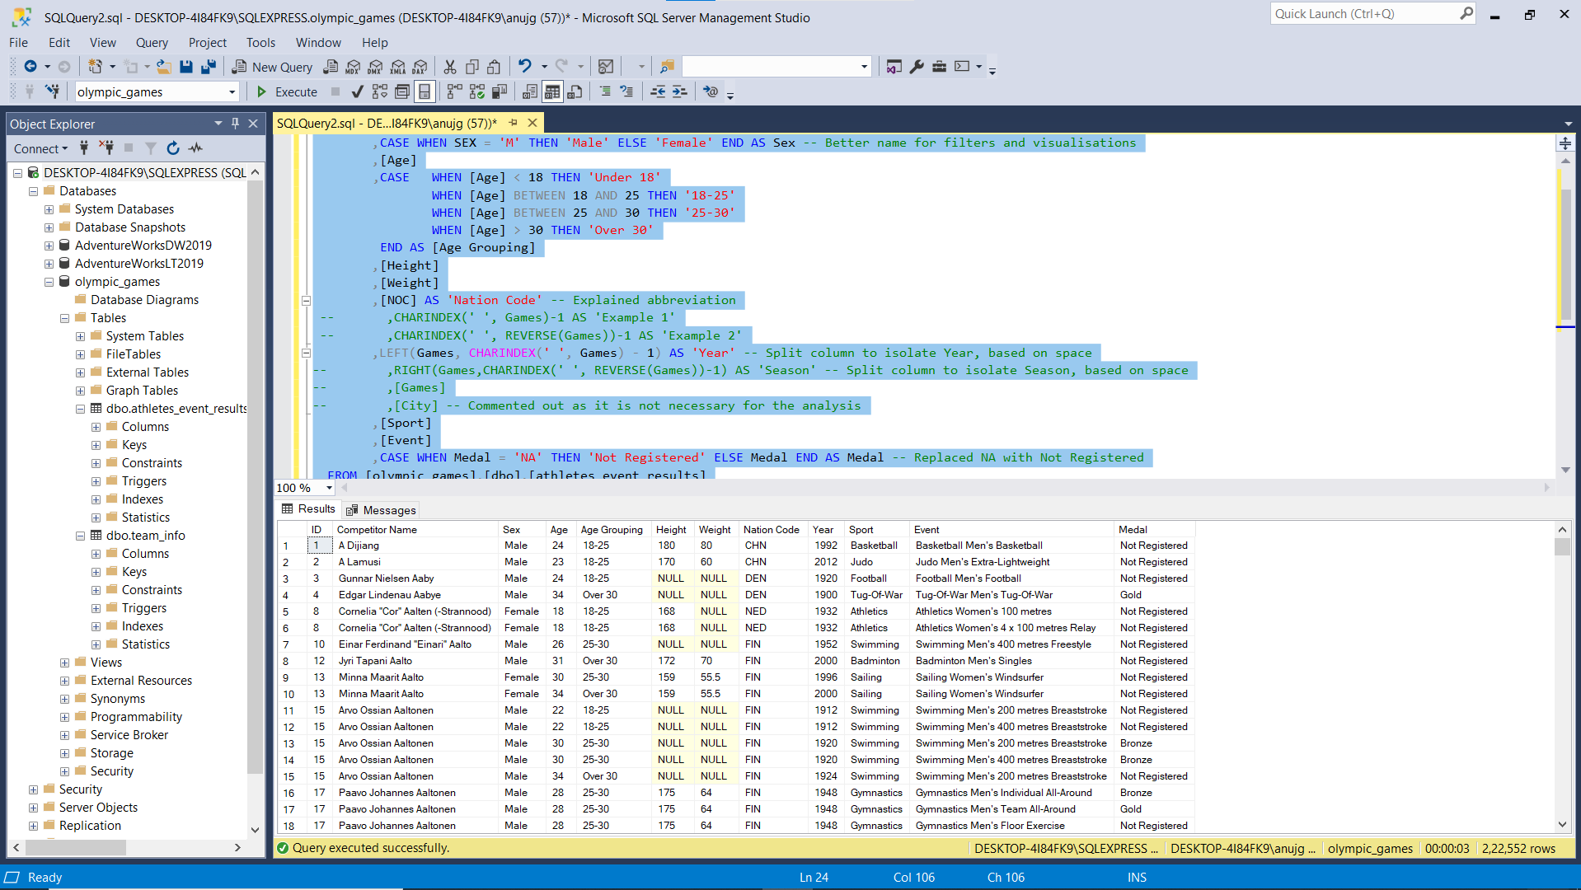

Slide 4
Business Problem
“As a Data Analyst Working at a news company You are asked to visualize data that will help readers understand how countries have performed historically in the summer Olympic games.
You also know that there is an interest in details about the competitors, So if you find anything interesting then don’t hesitate to bring that also.
The Main task is still to show historical performance for different countries, With the possibility to select your own country.”

Slide 5
Data Collection and Table Structures
SELECT
[ID]
,[Name] AS 'Competitor Name' -- Renamed Column
,CASE WHEN SEX = 'M' THEN 'Male' ELSE 'Female' END AS Sex -- Better name for filters and visualisations
,[Age]
,CASEWHEN [Age] < 18 THEN 'Under 18'
WHEN [Age] BETWEEN 18 AND 25 THEN '18-25'
WHEN [Age] BETWEEN 25 AND 30 THEN '25-30'
WHEN [Age] > 30 THEN 'Over 30'
END AS [Age Grouping]
,[Height]
,[Weight]
,[NOC] AS 'Nation Code' -- Explained abbreviation
-- ,CHARINDEX(' ', Games)-1 AS 'Example 1'
-- ,CHARINDEX(' ', REVERSE(Games))-1 AS 'Example 2'
,LEFT(Games, CHARINDEX(' ', Games) - 1) AS 'Year' -- Split column to isolate Year, based on space
-- ,RIGHT(Games,CHARINDEX(' ', REVERSE(Games))-1) AS 'Season' -- Split column to isolate Season, based on space
-- ,[Games]
-- ,[City] -- Commented out as it is not necessary for the analysis
,[Sport]
,[Event]
,CASE WHEN Medal = 'NA' THEN 'Not Registered' ELSE Medal END AS Medal -- Replaced NA with Not Registered
FROM [olympic_games].[dbo].[athletes_event_results]
WHERE RIGHT(Games,CHARINDEX(' ', REVERSE(Games))-1) = 'Summer' -- Where Clause to isolate Summer Season

Slide 6
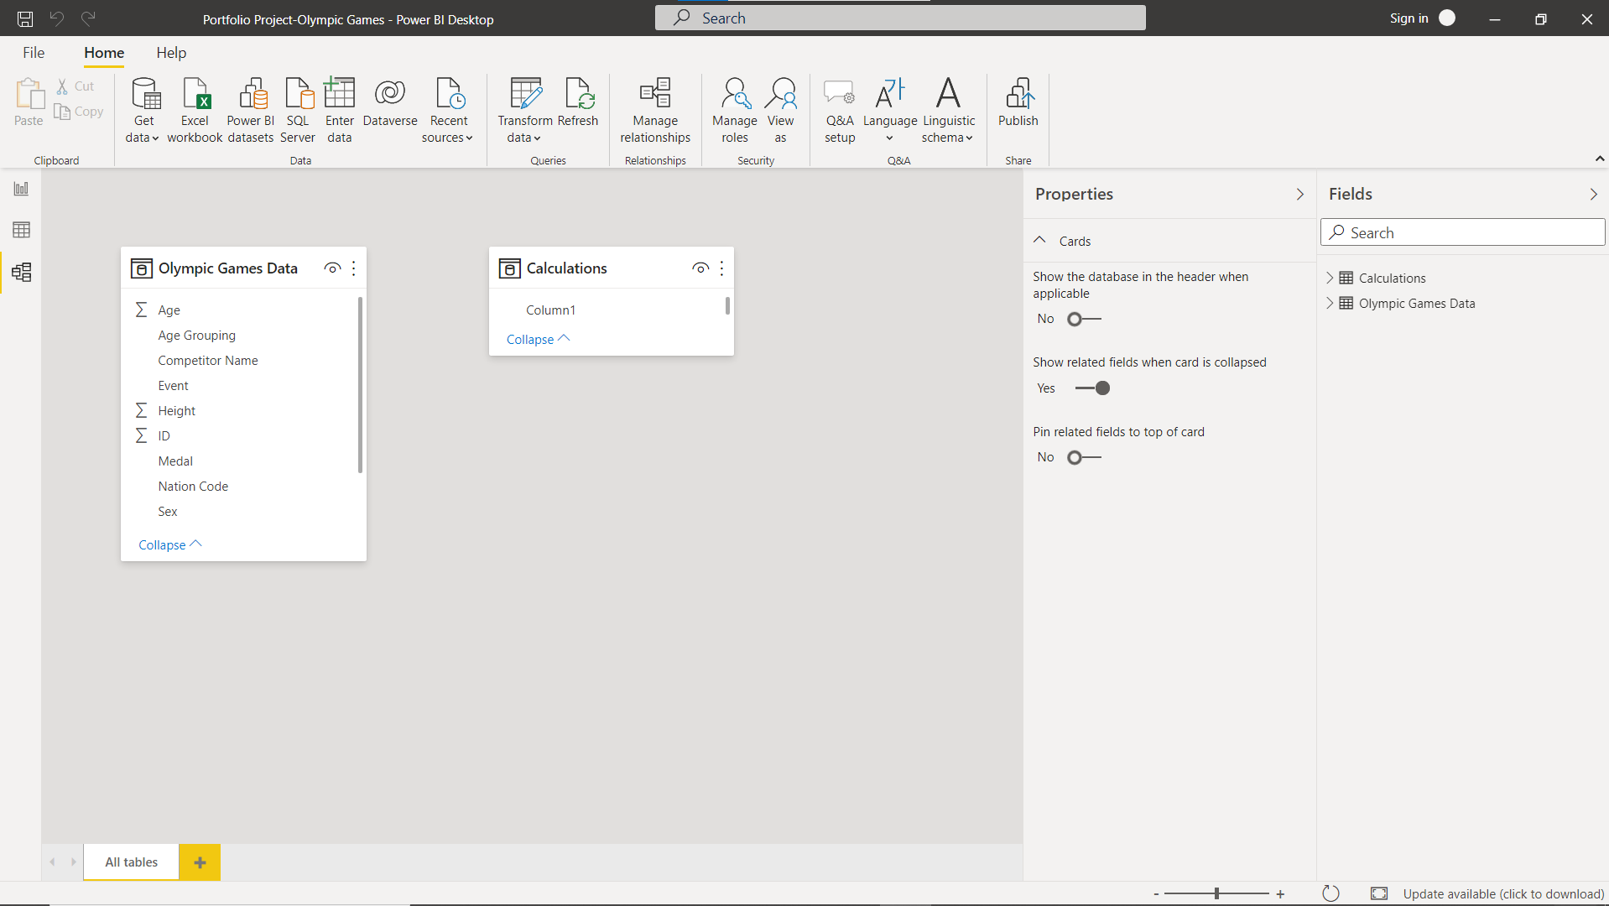
Data Model
As this is the view where dimensions and fact have been combined. The data model that is created in power bi two tables. The query from previous step was loaded in.

